Slide 1
Types of Sentences
Wrangling Up
Good Writing!
Declarative | Interrogatory | Exclamatory | Imperative

Slide 2
Sentences Do Different Jobs
When people use sentences, the sentences do many different jobs. Some ask questions, some give commands, some make a statement and others express a powerful feeling.

Slide 3
Four Main Types of Sentences
Did you know that there are 4 different kinds of sentences? It is important to learn about each type, so you can add pizzazz and punch to your writing.
Let’s look at the four main types of sentences and when you should use them in your writing.

Slide 4
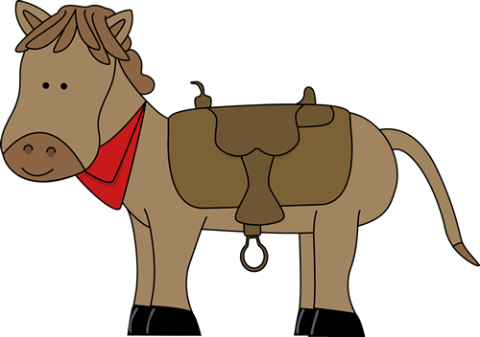
Declarative
The first type of sentence is called declarative. A declarative sentence makes a statement and always ends with a period. Here are some samples of declarative sentences:
I like red.
The sun is hot.
The horse is cute.

Slide 5
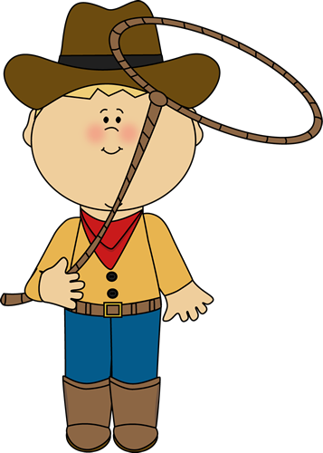
Declarative
Declarative sentences are the most common type of sentences. They always make a statement, and they always end in a period.

Slide 6
Imperative
The second type of sentence is called an imperative sentence. These are also called “command” sentences. An imperative sentence tells someone to do something.
Here are some sample imperative sentences:
Susan, get the door!
Open the window.
Grab my boots!
Each of these sentences is commanding someone to do something.

Slide 7
Imperative
Imperative or command sentences can end in either a period or an exclamation mark.
Get my cowboy hat!
Look in the car.
In both of these sentences, the subject “you” is implied. That means that the reader will know and understand that “you” is the subject, even though it is not written directly.

Slide 8
Interrogatory
The third type of sentence is called interrogatory. These are question sentences. Questions will always end with a question mark.
Do you like my hat?
What color is my bandana?
Have you seen my horse?

Slide 9
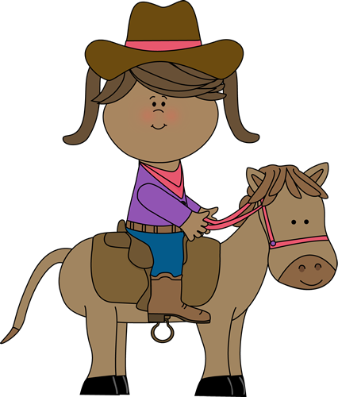
Exclamatory
Yippee!
The last type of sentence is called exclamatory. An exclamatory sentence shows strong feeling and always ends with an exclamation mark.

Slide 10
Exclamatory
Here are some more samples of exclamatory sentences:
Ouch! You hit me!
Surprise!
Look out! There’s a monster!

Slide 11
What kind of sentences are these?
Yikes! Here it comes!
I see the butterfly.
Go get me some milk.
Why are you crying?
What time is it?
Leave me alone.
The cactus is green.

Slide 12
Fix this story by adding some different types of sentences
I have a pet alien. It is small and green. It likes to eat cookies. It is really cute. I keep the alien in my bedroom. My mom saw it and screamed. She told me to get rid of it. I just hid it under my bed. I told my sister not to touch it. It is my friend.

Slide 13
Here is a sample…
Guess what? Did you know that I have a pet alien? It is small and green. I keep it in my bedroom. It is so cute! One day my mom saw it. “Yikes!,” she screamed. “Get that thing out of here!” I just hid it under my bed. “Don’t touch it!,” I told my sister. It is my friend.

Slide 14
Here is a sample…
Guess what? Did you know that I have a pet alien? It is small and green. I keep it in my bedroom. It is so cute! One day my mom saw it. “Yikes!,” she screamed. “Get that thing out of here!” I just hid it under my bed. “Don’t touch it!,” I told my sister. It is my friend.

Slide 15
Wrangle up Good Writing!
Using different types of sentences will really spice up your writing. When you write, be sure to include some of each type.

Slide 16
Let’s Review
Declarative – makes a statement and ends in a period
Imperative (command) – tells someone to do something. It can end in a period or exclamation mark.
Interrogatory – asks a question and ends in a question mark
Exclamatory – a sentence with strong feeling or emotion. It will always end in an exclamation mark.

Slide 17
The End
Clip art credits: mycutegraphics.com

